Slide 1



Python SciKit Learn Training
Trainer: Amir Othman
Website:www.tertiarycourses.com.my
Email:malaysiacourses@tertiaryinfotech.com
Notes:
Improvement
1. Add more links to datasets
2. Improve on PCA
3. Figure out how to export out the model for use after training
4. Add explanation to SGD, Decision Tree
5. Discuss a bit on the parameters for each classifier or add the links
6. More discussion on neural network

Slide 2
About me
- Software Engineer @ Instance http://www.instance.com.sg
- Education:
- Bauhaus Universität Weimar - Masters
- Hochschule Ulm – Bachelors
- Focus/Expertise:
- Machine Learning
- Software Engineering
- Data Visualization
- Works:
- www.kronologimalaysia.com
- www.diezeitachse.de

Slide 3
Agenda
Module 1 – Introduction
Module 2 – Datasets
Module 3 – Supervised Learning
Module 4 – Unsupervised Learning
Module 5 – Model Selection
Notes:
Improvements
PCA -> then do clustering
Add K-Means Clustering picture

Slide 4
Exercise Files
Download the exercise file from
https://github.com/tertiarycourses/SckitLearn
Notes:
http://www.tkdocs.com/tutorial/install.html#installwin

Slide 5
Module 1
Introduction

Slide 6
What is Machine Learning?
Machine Learning is about building programs with tunable parameters that are adjusted automatically so as to improve their behavior by adapting to previously seen data
Machine Learning is a subfield of Artificial Intelligence

Slide 7
Machine Learning Steps
Get Data
Clean and Preprocess Data
Shuffle (Randomize) Data
Split into Training/Test Data
Set Model Parameters - Learning Rate, Loss Function, Optimizer
Training the Model
Evaluate the Model
Use the Model

Slide 8
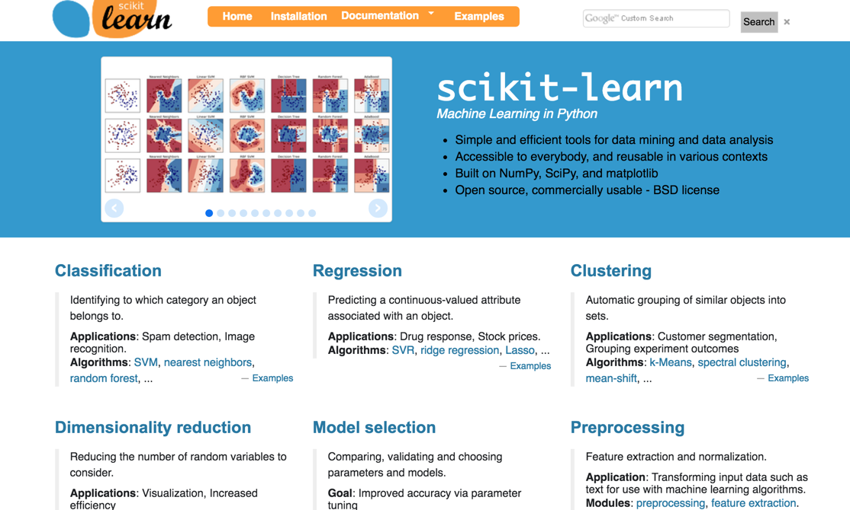
SciKit Learn
http://scikit-learn.org/

Slide 9
Scikits Learn Modules
Classifications
Regression
Clustering
Dimensional Reduction
Model Selection
Preprocessing

Slide 10
Module 2
Datasets

Slide 11
What is Dataset
A dataset is a dictionary-like object that holds all the data and some metadata about the data
This data is stored in the .data member which is a n_samples, n_features array
In the case of supervised problem, one or more response variables are stored in the .target member

Slide 12
Numerical Features
Continuous values Eg
sepal length in cm
sepal width in cm
petal length in cm
petal width in cm

Slide 13
Categorical Features
Discrete values Eg
color - RED, GREEN, BLUE
cities - LONDON, DUBAI, SHANGHAI

Slide 14
Module 3
Supervised Learning

Slide 15
What is Supervised Learning
In Supervised Learning, we have a dataset consisting of both features and labels.
The input data (X) is associated with a target label (y)

Slide 16
Supervised Learning Examples
Given a multicolor image of an object through a telescope, determine whether that object is a star, a quasar, or a galaxy.
Given a photograph of a person, identify the person in the photo.
Given a list of movies a person has watched and their personal rating of the movie, recommend a list of movies they would like

Slide 17
Classification

Slide 18
Key Classification Algorithms
K Nearest Neighbors (KNN)
Support Vector Machine (SVM)
Gaussian Naive Bayes (GND)
Stochastic Gradient Descent (SGD)
Decision Tree (DT)
Ensemble Methods

Slide 19
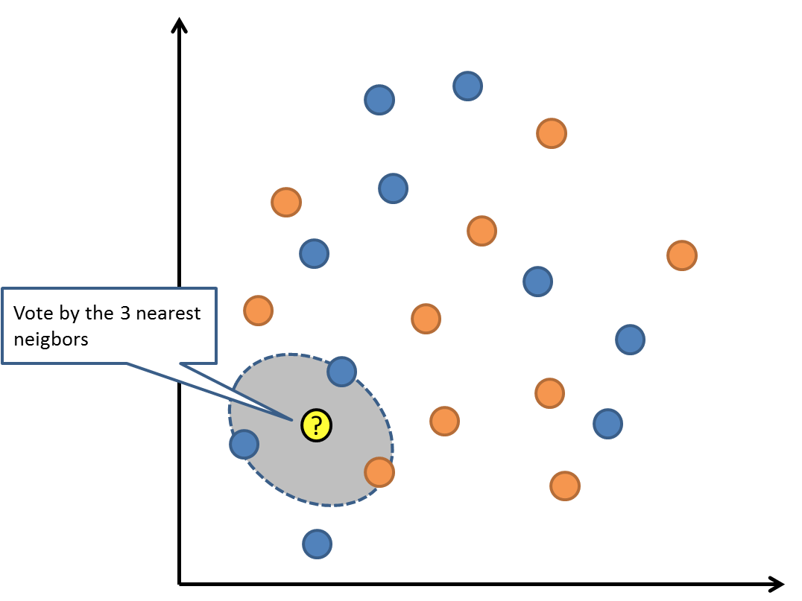
K Nearest Neighbors (KNN)
A simple majority vote of the nearest neighbors of each point:
Avoid using KNN on large dataset. It will probably take a long time
Notes:
http://scikit-learn.org/stable/modules/neighbors.html

Slide 20
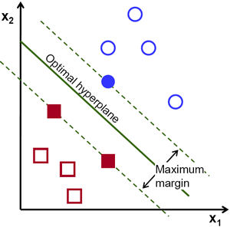
Support Vector Machine (SVM)
Identify hyperplane (boundary) with maximum distance apart
Use Kernels for nonlinear decision boundaries
Notes:
http://scikit-learn.org/stable/modules/svm.html

Slide 21

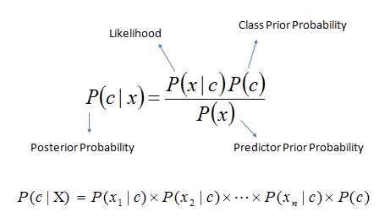
Gaussian Naive Bayes (GNB)
Use Probability Theory (Bayes Theorem)
All variables (features) are equally important and independent
Notes:
http://scikit-learn.org/stable/modules/naive_bayes.html

Slide 22
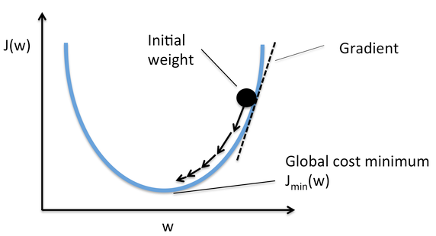
Stochastic Gradient Descent
Stochastic gradient descent (SGD) performs a parameter update for each training using the negative gradient
Notes:
http://scikit-learn.org/stable/modules/sgd.html

Slide 23
Decision Tree
Decision Trees (DTs) are a non-parametric supervised learning method used for classification and regression.
sq_ft > 1000?
Yes
No
price
+50,000
price
-50,000
sq_ft > 500?
sq_ft > 3000?
Yes
No
Yes
No
price
+50,000
price
-50,000
price
+150,000
price
-20,000
Notes:
http://scikit-learn.org/stable/modules/tree.html

Slide 24
Decision Tree Pros and Cons
Pros:
Simple to understand and to interpret. Trees can be visualized.
Able to handle both numerical and categorical data.
Cons:
Decision-tree learners can create over-complex trees that do not generalise the data well (prompt to overfitting)
Notes:
http://scikit-learn.org/stable/modules/tree.html

Slide 25
Random Forest Classifier
Random Forest classifier is a bagging ensemble method based on lots of decision trees with random selection of subsets of training samples
Tree 1
Tree 2
Tree 3
The result is based on the majority votes from all the decision trees
Notes:
http://scikit-learn.org/stable/modules/generated/sklearn.ensemble.RandomForestClassifier.html

Slide 26
Gradient Boosting Classifier
Gradient Boosting is a ensemble boosting method that "boosting" many weak predictive models into a strong one, in the form of ensemble of weak models.
Tree 1
Tree 2
Tree 3
+
+
Notes:
http://scikit-learn.org/stable/modules/generated/sklearn.ensemble.GradientBoostingClassifier.html#sklearn.ensemble.GradientBoostingClassifier

Slide 27
Classification Steps
# Step 1 Load classifier module
from sklearn import svm
clf = svm.SVC()
# Step 2 Learning/Training
clf.fit(digits.data,digits.target)
# Step 3: Testing/Predict
clf.predict(digits.data[1:2])

Slide 28
Classifier Methods
fit(X,y) : training with the training data set (X,y)
predict(X): predict with the test data (X)
score(X,y): Returns the mean accuracy on the given test data (X( and labels (y)

Slide 29
KNN Classifier
from sklearn import neighbors
clf = neighbors.KNeighborsClassifier()
clf.fit(X, y)
Notes:
http://scikit-learn.org/stable/modules/generated/sklearn.neighbors.KNeighborsClassifier.html

Slide 30
KNN Classifier Parameters
n_neighbor: number of neighbours (default=5)
weights: uniform, distance
algorithm: auto, ball_tree, kd_tree, brute
metric: minkowski
Notes:
http://scikit-learn.org/stable/modules/generated/sklearn.neighbors.KNeighborsClassifier.html

Slide 31
Sckit Learn Score Metric
clf.score(X_test,y_test)

Slide 32
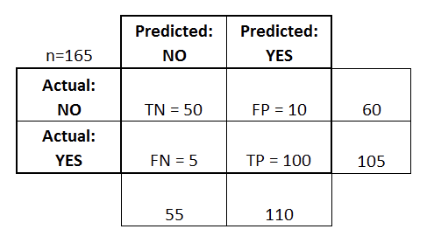
Confusion Matrix
True Positives (TP): We predicted positive, and the truth is positive.
True Negatives (TN): We predicted negative, and the truth is negative.
False Positives (FP): We predicted positive, but the truth is negative. ( "Type I error.")
False negatives (FN): We predicted negative, but the truth is positive. ("Type II error.")
Notes:
http://scikit-learn.org/stable/modules/generated/sklearn.metrics.confusion_matrix.html

Slide 33
Precision and Recall
Precision = TP/(TP+FP)
Recall = TP/(TP+FN)
We want high precision and high recall (true positive rate) metric for a good model

Slide 34
Classification Report
from sklearn import metrics
metrics.classification_report(expected, predicted)
precision recall f1-score support
0 1.00 1.00 1.00 11
1 0.94 0.94 0.94 16
2 0.91 0.91 0.91 11
avg / total 0.95 0.95 0.95 38

Slide 35
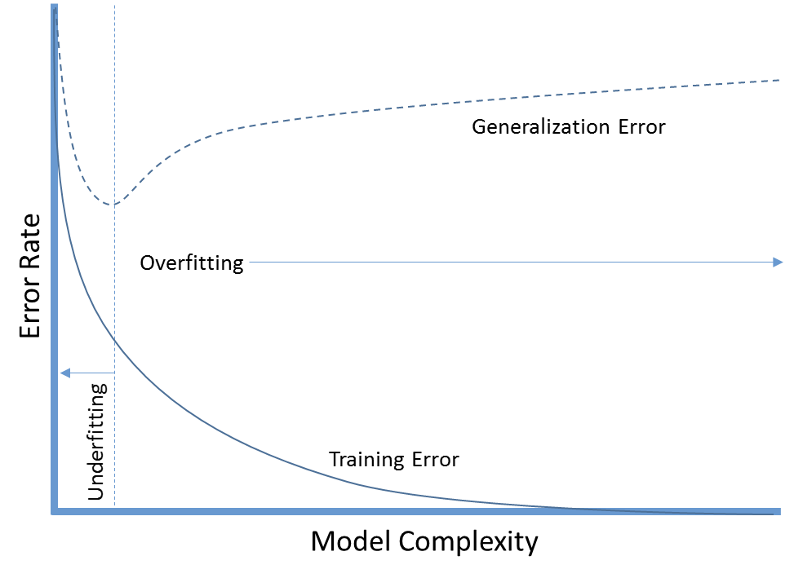
OverFitting and UnderFitting
Overfitting – model ‘memorizes’ training data
Underfitting – model unable to predict training data

Slide 36
Model Persistence
After training a scikit-learn model, it is desirable to have a way to persist the model for future use without having to retrain.

Slide 37
Model Persistence - Joblib
# Export the model
from sklearn.externals import joblib
joblib.dump(clf, 'mymodel.pkl')
# Import the model
from sklearn.externals import joblib
clf = joblib.load('mymodel.pkl')

Slide 38
Model Persistence - Pickle
# Export the model
import pickle
pickle.dump(clf, open("mymodel2.pkl","wb"))
# Import the model
import pickle
clf = pickle.load(open("mymodel2.pkl","rb"))
Notes:
https://docs.python.org/3/library/pickle.html

Slide 39
Regression

Slide 40
Key Regression Algorithms
Linear Regression
Logistics Regression
Decision Tree Regression
SGD Regression
Notes:
http://scikit-learn.org/stable/modules/generated/sklearn.linear_model.LinearRegression.html
http://scikit-learn.org/stable/modules/generated/sklearn.linear_model.LogisticRegression.html
http://scikit-learn.org/stable/auto_examples/tree/plot_tree_regression.html

Slide 41
Module 4
Unsupervised Learning

Slide 42
UnSupervised Learning
In Unsupervised Learning, we only have unlabeled input data
We are interested in finding similarities between the objects in question.
You can think of unsupervised learning as a means of discovering labels from the data itself.

Slide 43
Applications
Marketing: Help marketers discover distinct groups in their customer bases, and then use this knowledge to develop targeted marketing programs
Land use: Identification of areas of similar land use in an earth observation database
Insurance: Identifying groups of motor insurance policy holders with a high average claim cost

Slide 44
Clustering

Slide 45
What is Clustering?
Clustering is the task of grouping a set of objects in such a way that objects in the same group (cluster) are more similar to each other than to those in other groups (clusters).
Clustering is a unsupervised learning since no labels (targets) are needed for training.

Slide 46
Basic Steps in Clustering
Feature selection
  Must be properly selected so as to encode as much information as possible.
Proximity measure
  Quantifies how similar or dissimilar two feature vectors are.
Clustering Criterion
  Depends on the interpretation the expert gives to the term sensible.

Slide 47
Key Clustering Algorithms
K-Means
Mean Shift
Agglomerative Clustering

Slide 48
K-Means Clustering Method
Given k, the k-means algorithm is implemented as follows:
Partition objects into k nonempty subsets
Compute seed points as the centroids of the clusters of the current partition
Assign each object to the cluster with the nearest seed point
Repeat from Step 2, until no more new assignment

Slide 49
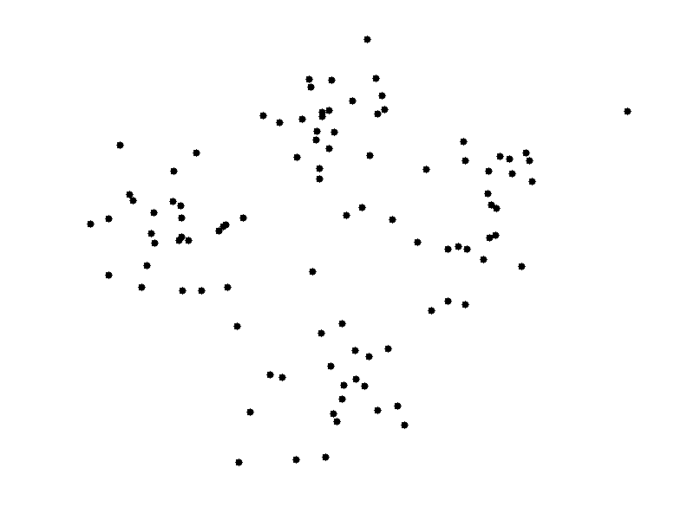
K Mean Algorithm Simulation
Click on the images below to start k-mean clustering simulation (k=4)
Seeds starts on left
Seeds randomly assigned

Slide 50
K-Means Pros & Cons
Pros:
Simple and fast, Easy to implement
Cons:
Need to choose K
Sensitive to outliers
Prone to local minima.
Extremely sensitive to initialization. Bad initialization can lead to:
  poor convergence speed
  bad overall clustering

Slide 51
K-Means Clustering
sklearn.cluster.KMeans(n_clusters = …)
n_clusters: number of clusters

Slide 52
Clustering Attributes
cluster_centers_: Coordinates of cluster centers
labels_ : Labels of each point

Slide 53
Clustering Steps
# Step 1 Model
from sklearn import cluster
cluster = cluster.KMeans(n_clusters=2)
# Step 2 Training
cluster .fit(X)
# Step 3 Evaluation
plt.scatter(X[:,0],X[:,1],c=cluster.labels_)
plt.show()

Slide 54
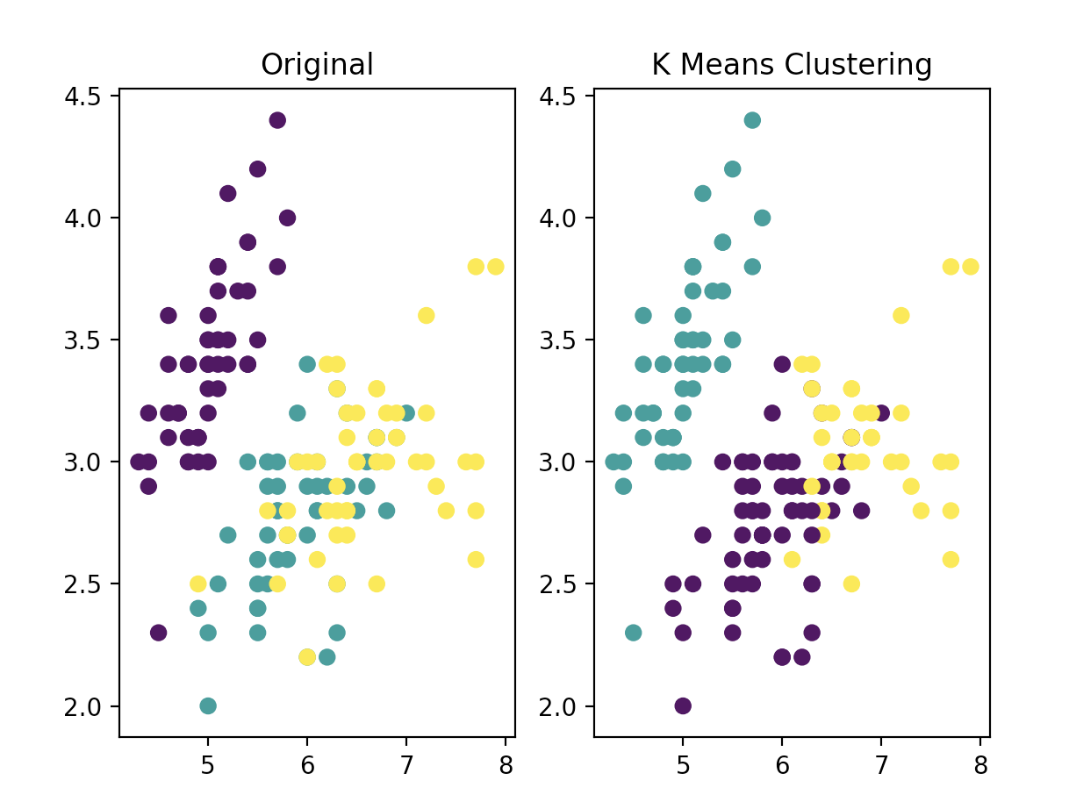
K- Means Clustering Demo
Blob generator dataset
Iris dataset

Slide 55
Challenge: K-Means Clustering
Apply K-Means Clustering to handwritten digits dataset
Time: 5 mins

Slide 56
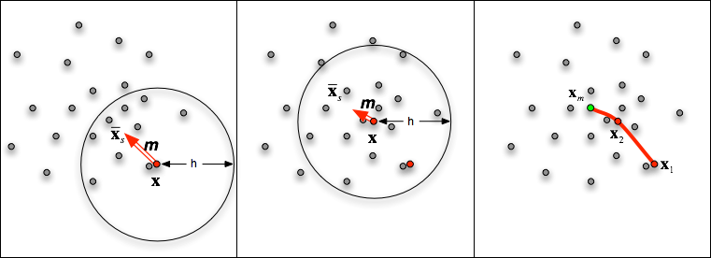
Mean Shift Clustering
sklearn.cluster.MeanShift()
Mean shift clustering is a centroid-based algorithm, which works by updating candidates for centroids to be the mean of the points within a given region
Notes:
http://scikit-learn.org/stable/modules/generated/sklearn.cluster.MeanShift.html#sklearn.cluster.MeanShift

Slide 57
Mean Shift Pros & Cons
Pros:
Don't need to specify number of clusters
Robust to outliers
Depend on single parameter - window size
Cons:
Output depends on window size
Computationally expensive

Slide 58
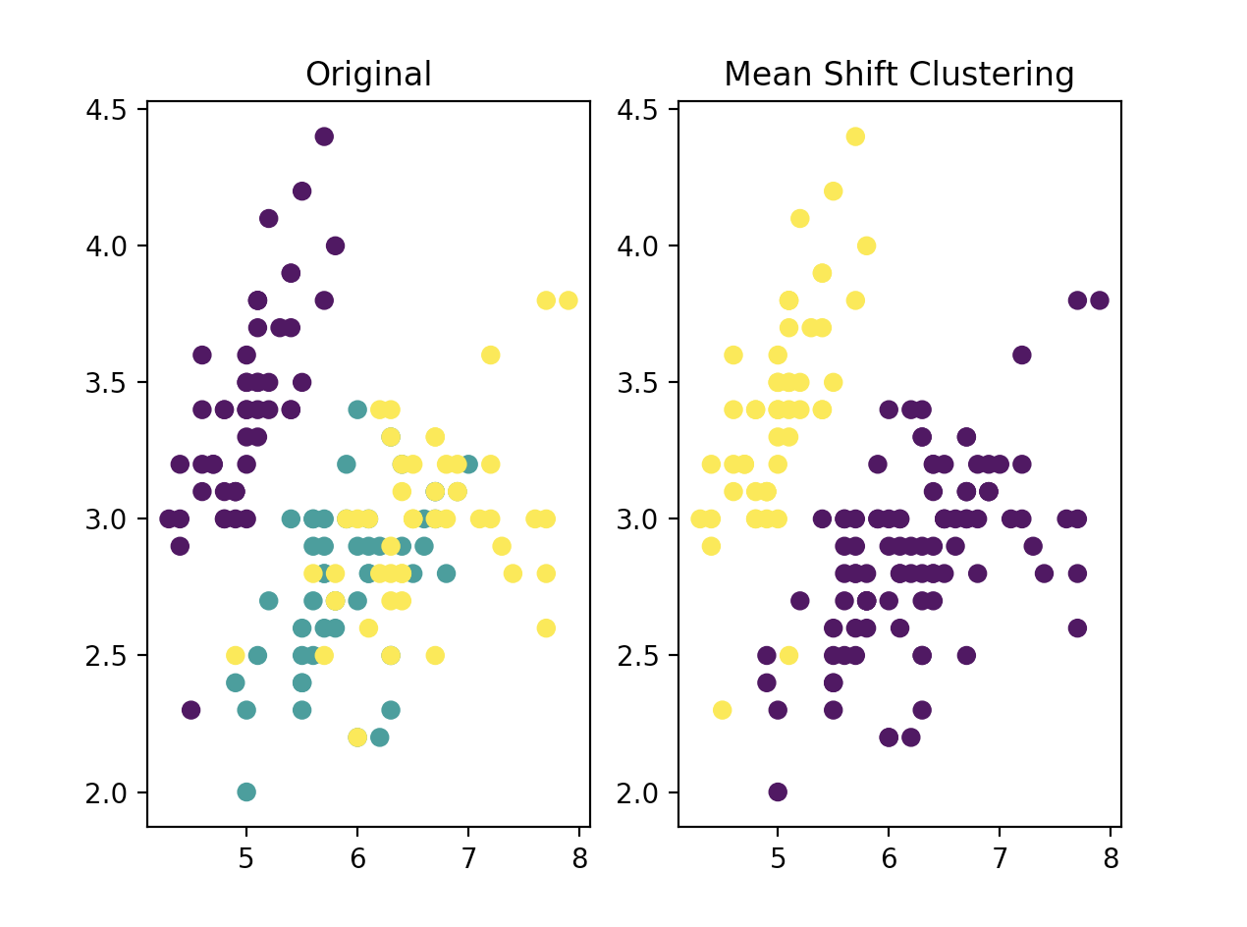
Mean Shift Clustering Demo
Blob generator dataset
Iris dataset

Slide 59
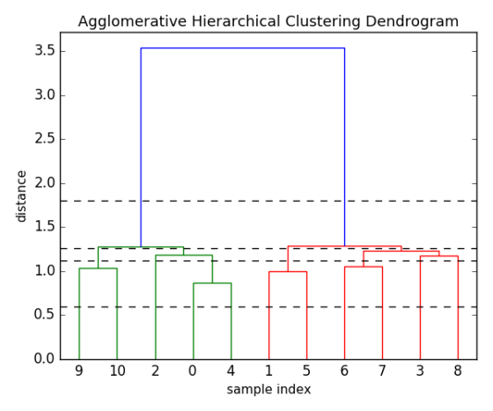
Hierarchical Clustering
Hierarchical clustering seeks to build a hierarchy of clusters. hierarchical clustering generally fall into two types:
Agglomerative: Bottom up approach
Divisive: Top down approach

Slide 60
Agglomerative Clustering
sklearn.cluster.AgglomerativeClustering(
n_clusters = 2, affinity = 'euclidean', linkage = 'ward'..)
Notes:
http://scikit-learn.org/stable/modules/generated/sklearn.cluster.AgglomerativeClustering.html

Slide 61
Affinity
Metric used to compute the linkage.
euclidean,
l1
l2
manhattan
cosine
precomputed
If linkage is “ward”, only “euclidean” is accepted.
Notes:
http://scikit-learn.org/stable/modules/generated/sklearn.cluster.AgglomerativeClustering.html

Slide 62
Linkage
The linkage criterion determines which distance to use between sets of observation. The algorithm will merge the pairs of cluster that minimize this criterion.
ward
average
complete
Notes:
http://scikit-learn.org/stable/modules/generated/sklearn.cluster.AgglomerativeClustering.html

Slide 63
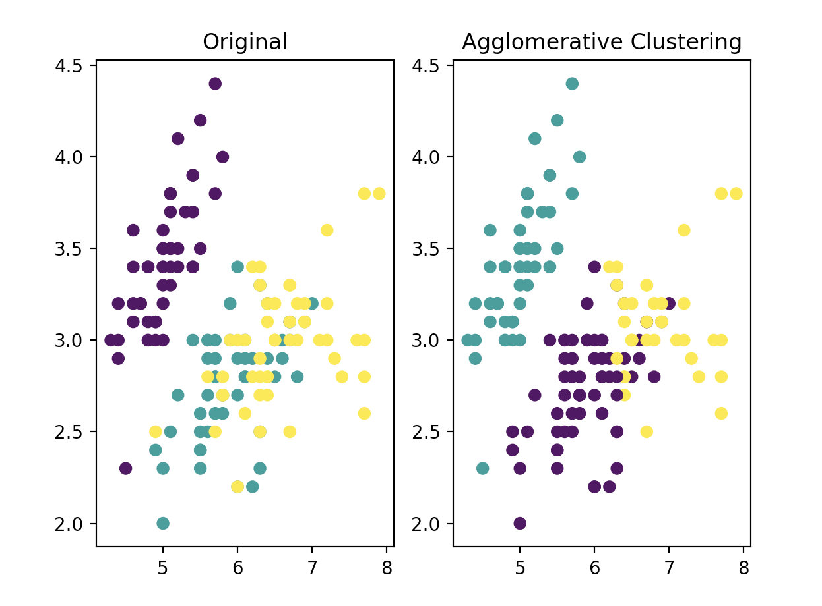
Agglomerative Clustering Demo
Blob generator dataset
Iris dataset

Slide 64
Dimensionality Reduction

Slide 65
Principal Component Analysis
Principal component analysis (PCA) is a dimensionality reduction technique.
Suppose you have 10 features (dimensions), and you can use use PCA to reduce it to a few key features (dimensions) that can capture the most variation of the data.
PCA was invented in 1901 by Karl Pearson

Slide 66
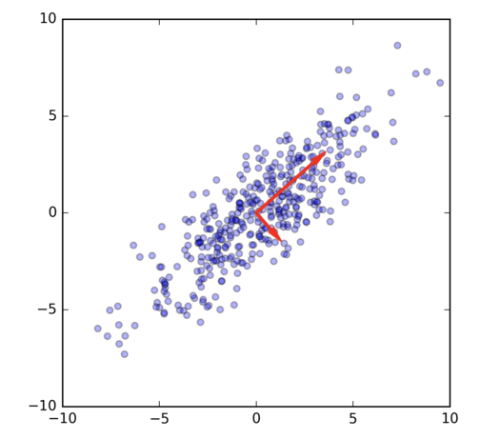
Principal Component Analysis
PCA Component 1
PCA Component 2
The principle components have the largest variations

Slide 67
SK PCA Attributes
explained_variance_: The amount of variance explained by each of the selected components.
explained_variance_ratio_: Percentage of variance explained by each of the selected components.
components_: Principal axes in feature space, representing the directions of maximum variance in the data. The components are sorted by explained_variance_.
n_components_: The estimated number of components

Slide 68
SK PCA Methods
fit(X): Fit the model with X
transform(X): Apply dimensionality reduction to X.
fit_transform(X): it the model with X and apply the dimensionality reduction on X.

Slide 69
PCA Simple Demo
X = np.array([[-1, -1], [-2, -1], [-3, -2], [1, 1], [2, 1], [3, 2]])
from sklearn import decomposition
pca = decomposition.PCA(n_components=2)
pca.fit(X)

Slide 70
PCA on Iris Dataset
pca = decomposition.PCA(n_components=2)
pca.fit(X)
X_t = pca.transform(X)

Slide 71
PCA Components
To determine the components,
comps = pd.DataFrame(pca.components_, columns=iris.feature_names)
sepal length (cm) sepal width (cm) petal length (cm) petal width (cm)
0 0.361590 -0.082269 0.856572 0.358844
1 0.656540 0.729712 -0.175767 -0.074706
2 -0.580997 0.596418 0.072524 0.549061
3 0.317255 -0.324094 -0.479719 0.751121

Slide 72
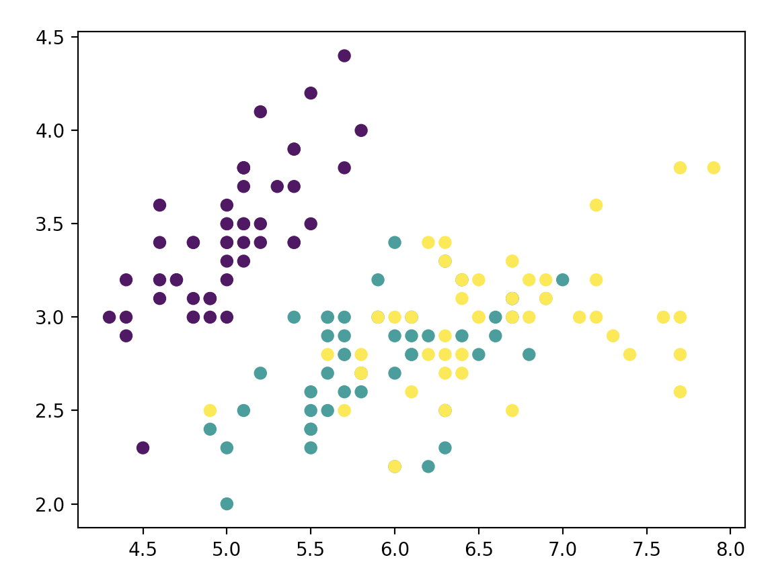
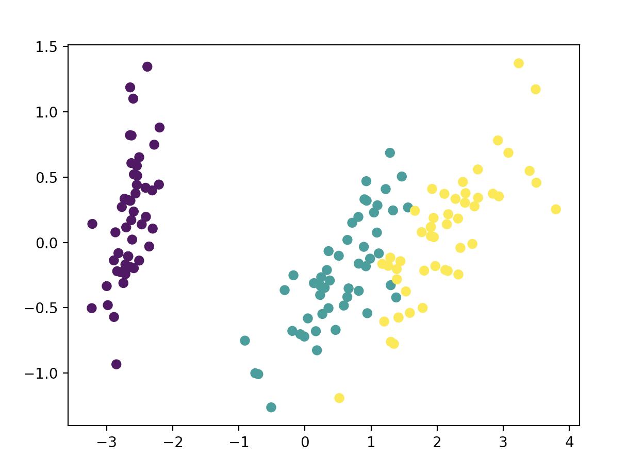
PCA vs Original
Original X₁ vs X₂
PCA X₁ vs X₂

Slide 73
Module 5
Model Selection

Slide 74
Tuning the hyper-parameters of an estimator
- Hyper-parameters - are not directly learnt within estimators
- Search the hyper-parameter space
- Exhaustive Grid Search
- Randomized Parameter Search

Slide 75
Pipeline and FeatureUnion: combining estimators
- Useful as there is often a fixed sequence of steps in processing the data
- Convenience and encapsulation
- Joint parameter selection

Slide 76
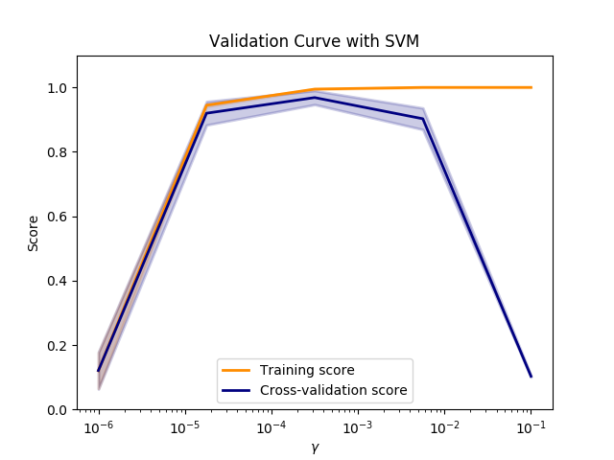
Validation curve

Slide 77
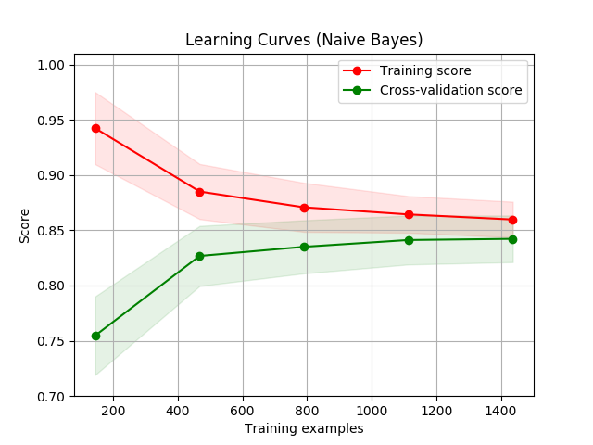
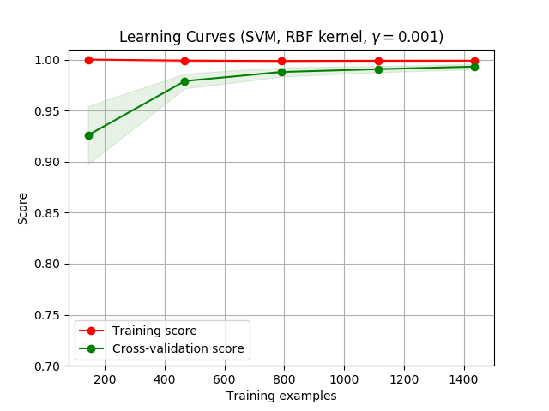
Learning curve
- Shows the validation and training score of an estimator

Slide 78
Summary
Parting Message

Slide 79
Q&A
Feedback

Slide 80
Thank You!
malaysiacourses@tertiaryinfotech.com

